Slide 1
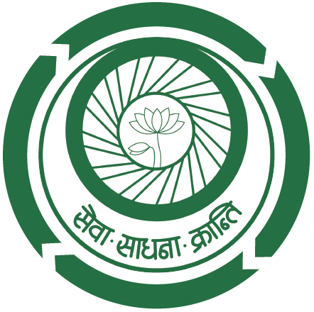

S E V A M A N D I R
C A S E S T U D Y S E G M E N T
I M P A C T A S S E S S M E N T
O N
R E P R O D U C T I V E H E A L T H M O D U L E
G u I d e d B y -
P R E S E N T I N G B y -
P R O F. N I R M A L K U M A R M A N D A L
R A K T I M D H A R A
( 2 0 2 0 1 0 4 8 )
M B A - R M, 2 0 2 0 – 2 2
R E P O R T I N G O F F I C E R
M U N E N D R A S I N G H C H A U H A N
Notes:
Good evening one and all present here. I, Raktim Dhara will be presenting on impact analysis on reproductive health module. I want to thank my faculty guide, prof nirmal mandal and reporting officer Munendra sir for all the guidance I have got.

Slide 2
c o n t e n t s
About the Organization
Context
Objectives
Methodology
Data Source
Geographical & Demographic Identity
Data Analysis
Findings
Limitations
Learnings
Suggestions
Module
References
Notes:
So today I will talk about the organization, context, objectives, methodology, data analysis, findings and concluding it with my learnings.

Slide 3




T H E O R G A N I S A T I O N
Seva Mandir is a non-profit organization based in Udaipur, southern Rajasthan, India. Conceived in the 1930s, the organization was founded in 1968 by Dr Mohan Singh Mehta,
Natural Resource Management
Women Empowerment
Education
Childcare & Empowerment
Notes:
So as my friend Manisha also told Seva Mandir is a non-profit organisation based in Udaipur, southern Rajasthan, India. The organisation was founded in 1968 by Dr Mohan Singh Mehta, who had been a distinguished Ambassador, administrator and educationalist.
Their overall work revolves around Natural Resource Management, Women Empowerment, Education, Childcare, Malnutrition,/

Slide 4



T H E O R G A N I S A T I O N
Seva Mandir is a non-profit organization based in Udaipur, southern Rajasthan, India. Conceived in the 1930s, the organization was founded in 1968 by Dr Mohan Singh Mehta,
Malnutrition
WASH
Improving Livelihoods
Notes:
Water -Sanitation and Hygeine, and increasing the livelihood opportunities of the people./

Slide 5
C O N T E X T
In 2018, Seva Mandir launched the ‘Rural Football Program on Rajasthan Youth,' which focuses mostly on adolescents (14-18yrs) and aims to improve interpersonal skills such as communication, leadership, and teamwork. Furthermore, the organization has made significant measures to address issues like good and bad touch, water sanitation and hygiene, gender equality, reproductive health, and communicable and non-communicable diseases. In respect of these different modules are being prepared. I was assigned to prepare one such module on ‘Reproductive Health’.
Notes:
3 years ago Seva Mandir started a program, ‘Rural Football Program on Youth of Rajasthan’ emphasizes predominantly on adolescents(14-18yrs) to enhance interpersonal skills such as communication, leadership, teamwork etc. In addition, organization has taken effective steps to address concerns such as good and bad touch, water sanitation and hygiene, gender equality, reproductive health, and non-communicable diseases. In respect of these different modules (or guidebooks) are being prepared. I was assigned to prepare one such module on ‘Reproductive Health’. Organization told me that if they find the module effective, then the module will be implemented over all the children.
That’s why I have done an Impact Assessment of the module.

Slide 6
O B J E C T I V E S
1
To get an idea about the existing knowledge of the children regarding reproductive health and through intervention enhance that.
2
To make adolescent girls understand the importance of good menstrual hygiene and practices.
3
To provide knowledge about different STDs.
4
To give an insight about the importance of family planning and different population control methods.
5
To make children understand the drawbacks of teenage pregnancy.

Slide 7
M E T H O D O L O G Y
1
2
3
4
Got a list of children.
Choose 60 children..
6 YRCs. 10 from each.
5 Girls, 5 Boys.
2 sets Questionnaire.
10 Questions each.
5 Point Likert Scale.
Telephonic Interview.
Module Preparation.
5
6
7
Data collection for Post-Test from 60 children.
30 Boys ; 30 Girls
Data Analysis by SPSS & MS Excel.
Pilot Testing through Zoom.
Notes:
After the basic introduction of the project, organization provided a list of children who are under their program. Selected 60 children as the sample. There are 6 YRCs (Youth Resource Center) and from every YRC choose 10 children. 5 girls and 5 boys./
For the evaluation 2 set of questionnaires have been prepared respectively for Pre – Test & Post – Test. Each questionnaire consisting of 10 questions. Used 5 point Likert Scale for the rating. (1-5)./
All the primary data have been collected through telephonic interview. /
Depending upon the Pre – Test data collected, a targeted module has been prepared to enhance the respected subject knowledge./
Pilot test conducted through Zoom for 30 children, which was my test group./
After 21 days Post- Test data collected from the same 60 children over phone./
All the data have been analyzed with the help of SPSS./

Slide 8
D a t a S o u r c e
P
S
P R I M A R Y
S E C O N D A R Y
Organization Resources
Literature Review
YouTube
Telephonic Interview of 60 Children.
Notes:
My primary data source was 60 children, from which I have received all the data./
For the secondary data, I looked at the organizational resources, Literature review mainly Biology Books, different websites and I have also watched multiple YouTube videos./

Slide 9
S T R A T E G I E S A D O P T E D
01
02
03
Response Time
&
Choice of words
Morphed Questions
Reverse Psychology
Instead of asking direct questions from the questionnaire, framed situations and ask the children how they would react to a particular situation.
Asking or telling them to do the exact opposite of what you really want them to do.
Assess the child if they had a view point on a particular issue rather than evaluating only their answers. Also also analyzed the tone in which the child put forward his/her point

Slide 10
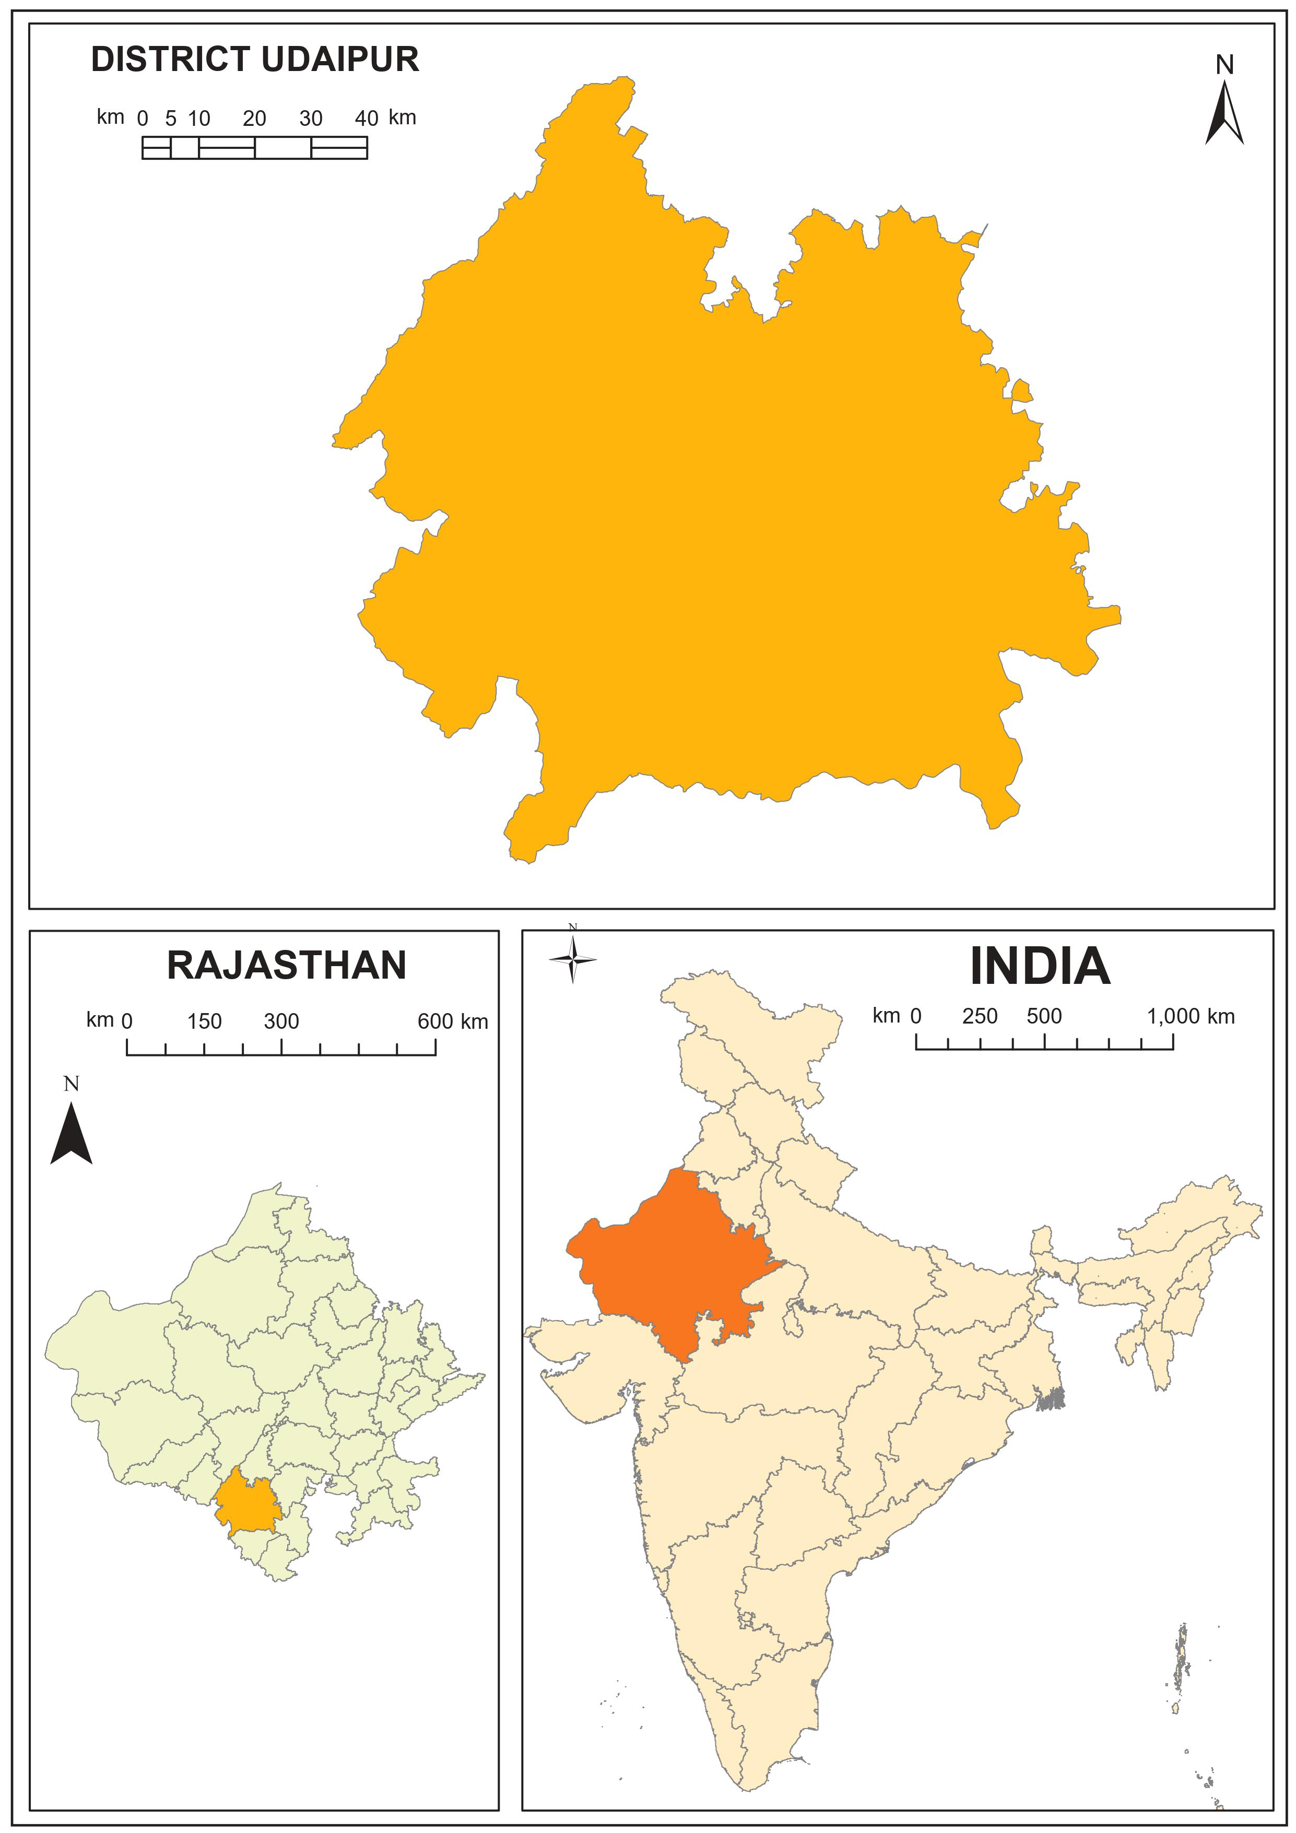
g e o g r a p h I c a l I d e n t I t y
YRC
Dist. HQ
Rama
Udaipur Town
Girwa
Som
Birothi
Madla
Jhunthri
Notes:
This the geographical coverage of my study. I have taken data from these 6 YRCs, which all come under the Udaipur District of Rajasthan./

Slide 11
D E M O G R A P H I C I d e n t I t y
OBC
(5%)
HS
(25%)
ST
(7%)
Total Sample Size 60
Test Group 30
Control Group 30
Education
Social
Category
Secondary
(75%)
SC
(28%)
General
(60%)
Name of YRC | Birothi | Som | Rama | Jhunthri | Madla | Griwa
No. of Children | (5+5) | (5+5) | (5+5) | (5+5) | (5+5) | (5+5)
A G E
14 - 18
G E N D E R
Boys – 50% ; Girls – 50%
R E L I G I O N
Hindu – 95% ; Muslim – 5%
Notes:
Total Samle Size 60. Test Group 30, Control Group 30.
From each YRC, 5 children are in control group, 5 are in test group./
The age of the children are betwwn 14 to 18./

Slide 12
D A T A O V E R V I E W
Pre-Test Questions 10
Post-Test Questions 10
Score for Each Question Ranges Between 1 to 5
A Child’s Final Score Can Lie Between 10 to 50
50
Complete Knowledge about Reproductive Health
No Knowledge about Reproductive Health
10

Slide 13
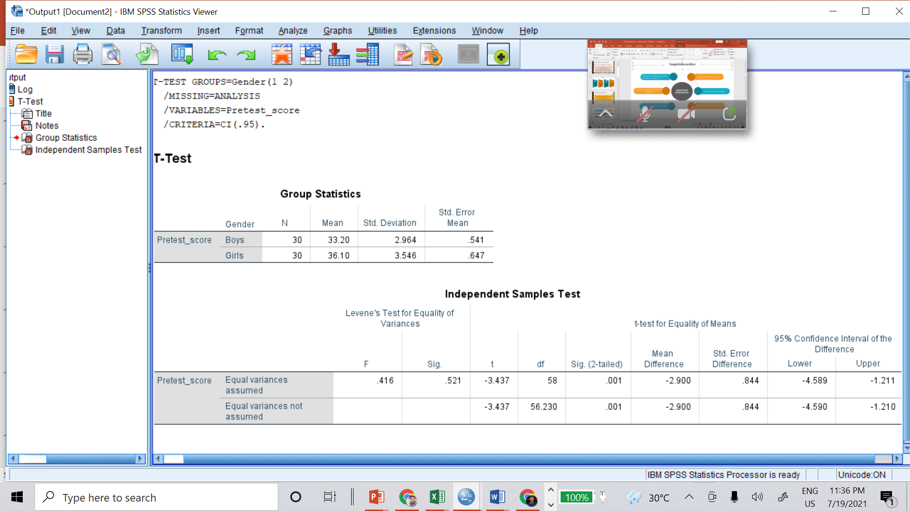
B O Y S – G I R L S (Pre-test)
Independent Sample t-Test
Girls Boys
Independent Variable
2.90
Gender – Girls & Boys
Dependent Variable
Pre-Test Score
Decision Rule for Levene’s Test
Decision Rule for Significance Test
If Sig <= 0.05, Variances are Significantly Different. Interpret the Bottom Row.
If Sig > 0.05, Variances are Not Significantly Different. Interpret the Top Row.
If p <= 0.05, Test is Significant.
If p > 0.05, Test is Not Significant.
Notes:
I have done a pre test comparison between boys and girls to find out their knowledge level about reproductive health using independent sample t test. Independent variableis gender and devendent variable pre test score./
Now if we compare the means of both groups, girls mean is higher./
The gap is is almost 3.
Now if we look at the indepent sample t test table, first we have to look at the sig value of the levene’s test,/
The rule for levene’s test is if sig value is greater than 0.05, then we have to interpret the top row. Otherwise interpret the lower one. Here we can see the sig value is higher than 0.05, so we will look at the top row./
Next we have to look for the p value. This sig 2 tailed value and p value is similar./
Now if the p value is less than equal to 0.05 the test is significant.
We can see that, girls had more knowledge than the boys about the reproductive health./
This a line graph of pre test scores of boys and girls.

Slide 14
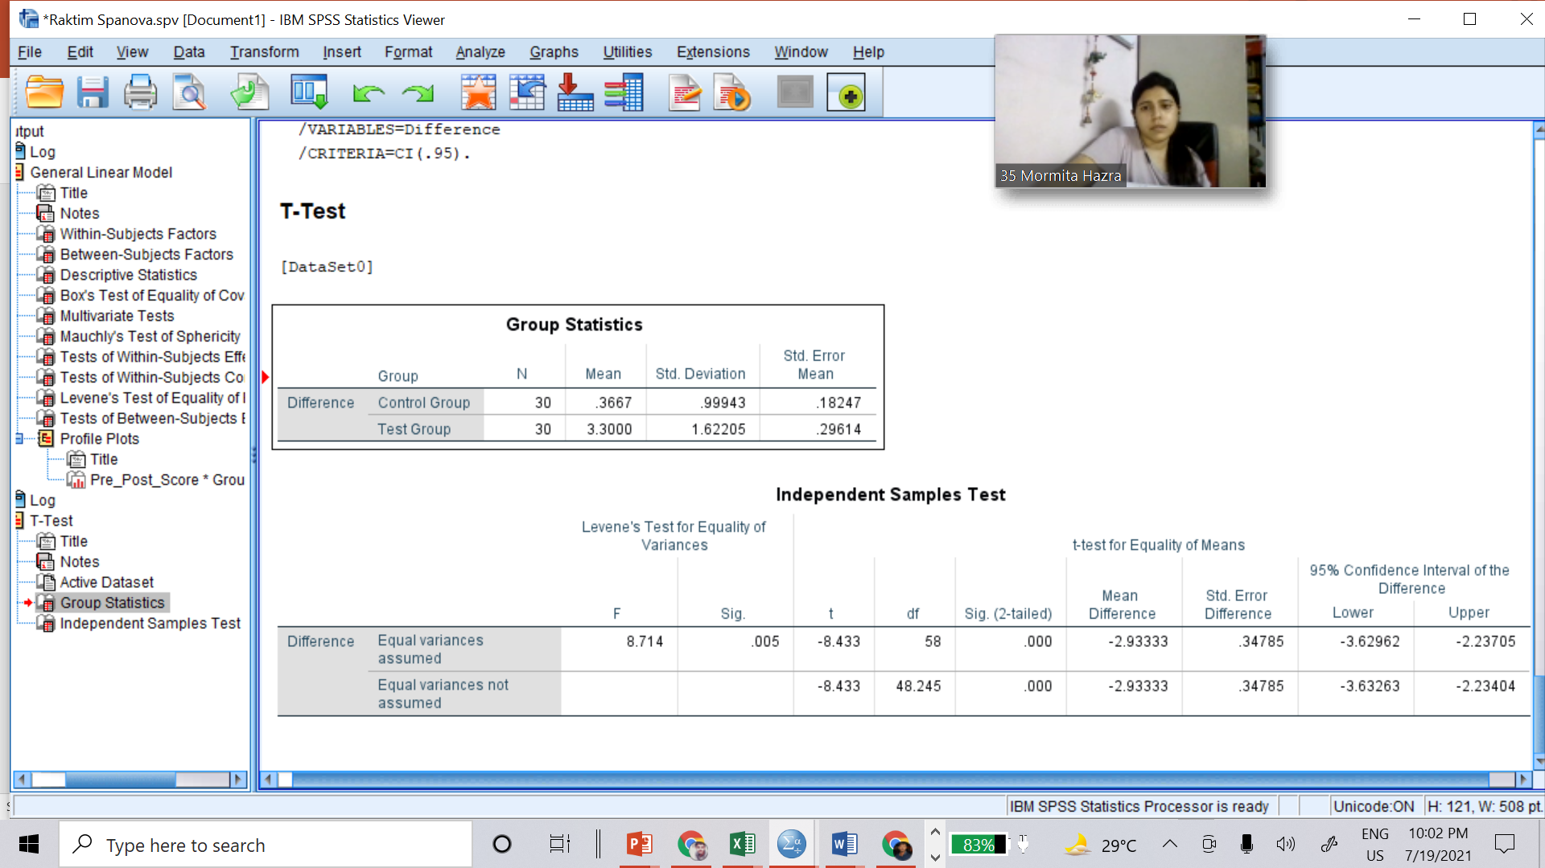
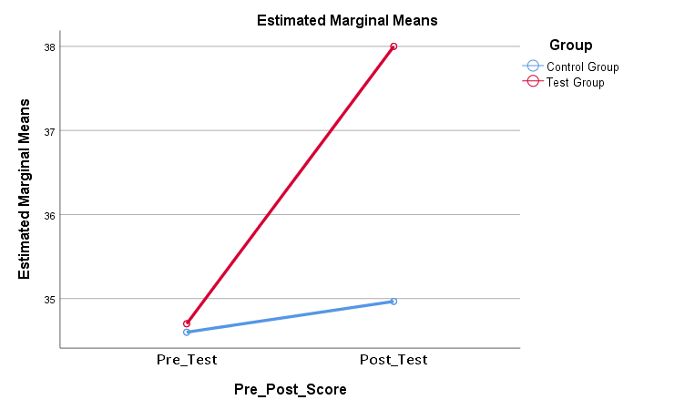
I m p a c t a s s e s m e n t
Independent Sample t-Test
3.30 - 0.37 =
2.93
Independent Variable
Group – Control & Test
Dependent Variable
Difference Between Pre & Post Test
Decision Rule for Significance Test
If p <= 0.05, Test is Significant.
If p > 0.05, Test is Not Significant.
Decision Rule for Levene’s Test
If Sig <= 0.05, Variances are Significantly Different. Interpret the Bottom Row.
If Sig > 0.05, Variances are Not Significantly Different. Interpret the Top Row.

Slide 15
f I n d I n g s
The intervention have made a little impact.
Girls have more knowledge about ‘Reproductive Health’ than the boys.
Boys don’t talk about these topics with their parents. Their primary source of knowledge
are peer groups and school.
At the time of pilot testing the module, I felt that girls were less expressive than boys.

Slide 16
L i m i t a t i o n s
Time
Truthful Response from Children
Telephonic Interviews
Small Sample Size
Final Scoring
Notes:
Time is a big constraint this study. If we get more time perhaps the intervention would create more impact.
Somethimes I feel than children were giving only the correst answers instead of telling what they actually thought.
I feel that face to face interactions would be much better than the telephonic interviews.
Because of the time constraints, I have to choose a smaller sample. If the sample was bigger, the study would be more acuurate.
For the final scoring, there is scope for human error to have occurred while the interviewer was assessing the children.

Slide 17
L E A R N I N G S
Adaptation is Key
Lessons from the Children
Data Analysis is not Boring
Online Internship < Field Internship
Notes:
During my internship I have faced many problems like network connectivity issue, understanding the dialects from the children. This online internship is also a bag barrier. So, adaptation is needed in every step./
For this study I have talked with many children. Talks with them about their reactions to difficult situations, we realised that a lot of them looked even daunting situations as challenges that could be overcome. It is often said that children can show you how to dream without inhibitions, but it was refreshing and humbling to see youth from impoverished backgrounds strive to rise beyond what life dealt to them./
For this project , first time I have tried SPSS and it is interesting to learn all the different data analysis models like ANOVA, t – tests./
And last but not the least, field internships are always much better than the online internship./

Slide 18
s u g g e s t I o n s
Knowledge is Power
‘ S E X ’ Don’t Make it a Taboo
Fathers, Be a Friend (Sometimes)
School Curriculum is Not Enough
Notes:
We all say that the more we share knowledge, the more you get. But I find it that we don’t talk about our reproductive health openly. Somehow we have made the ‘ Sex’ word a taboo. For the girl children, they still can discuss somethings with their mothers but boys are not the same. Fathers need to initiate the conversations with the boys. Children shouls learn about this topics from an early age. Otherwise a 2-3 years school will not be enough.

Slide 19
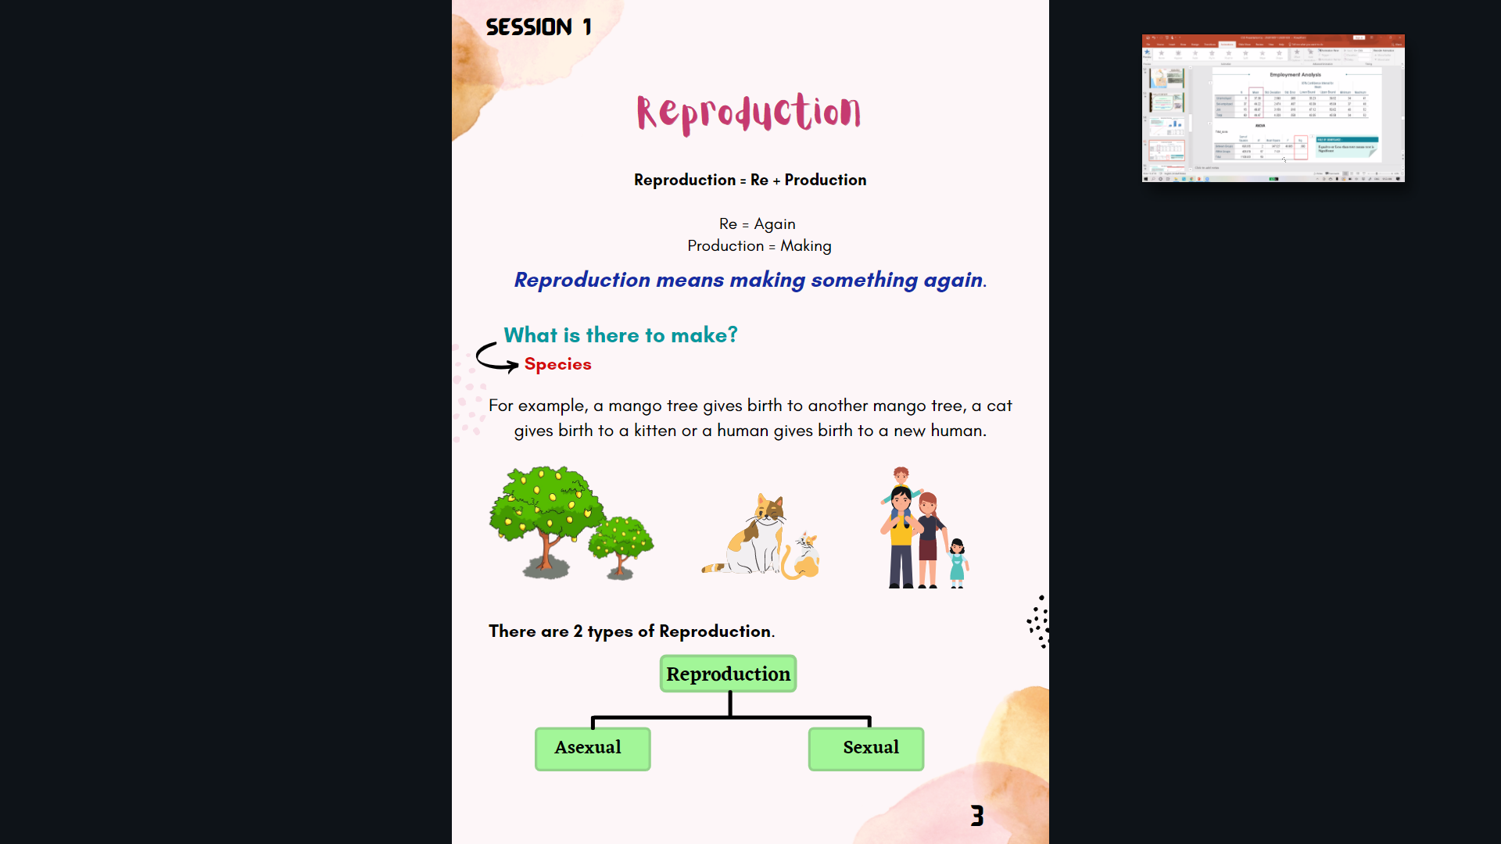
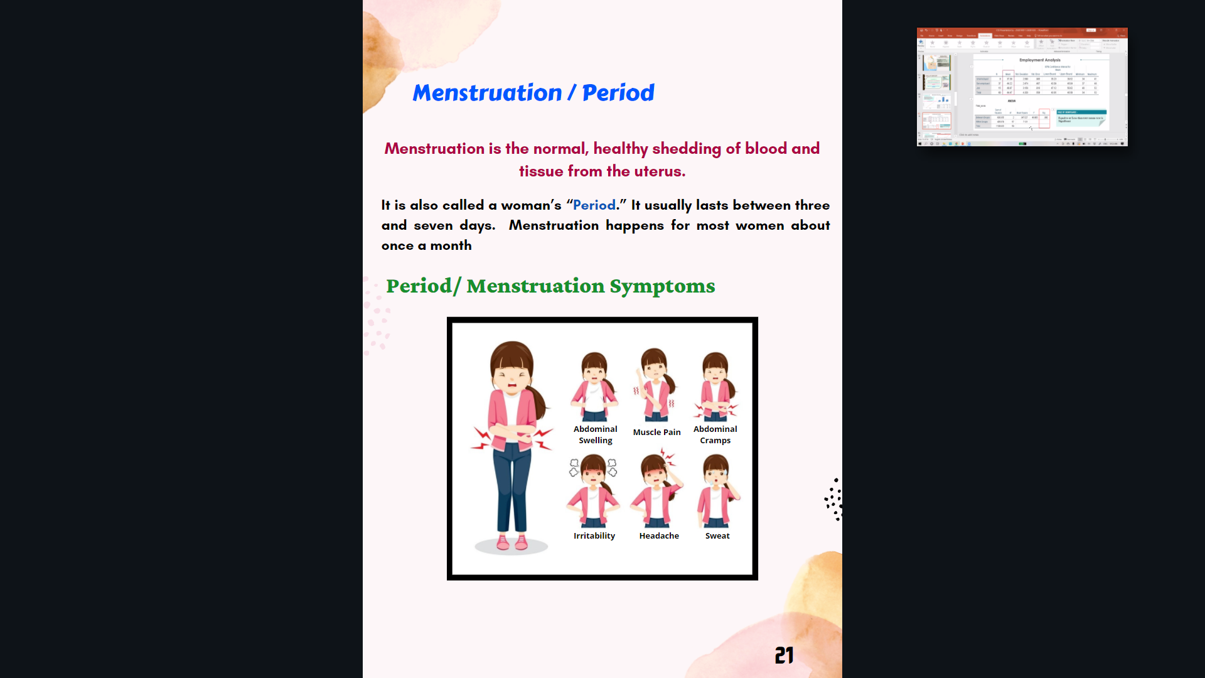
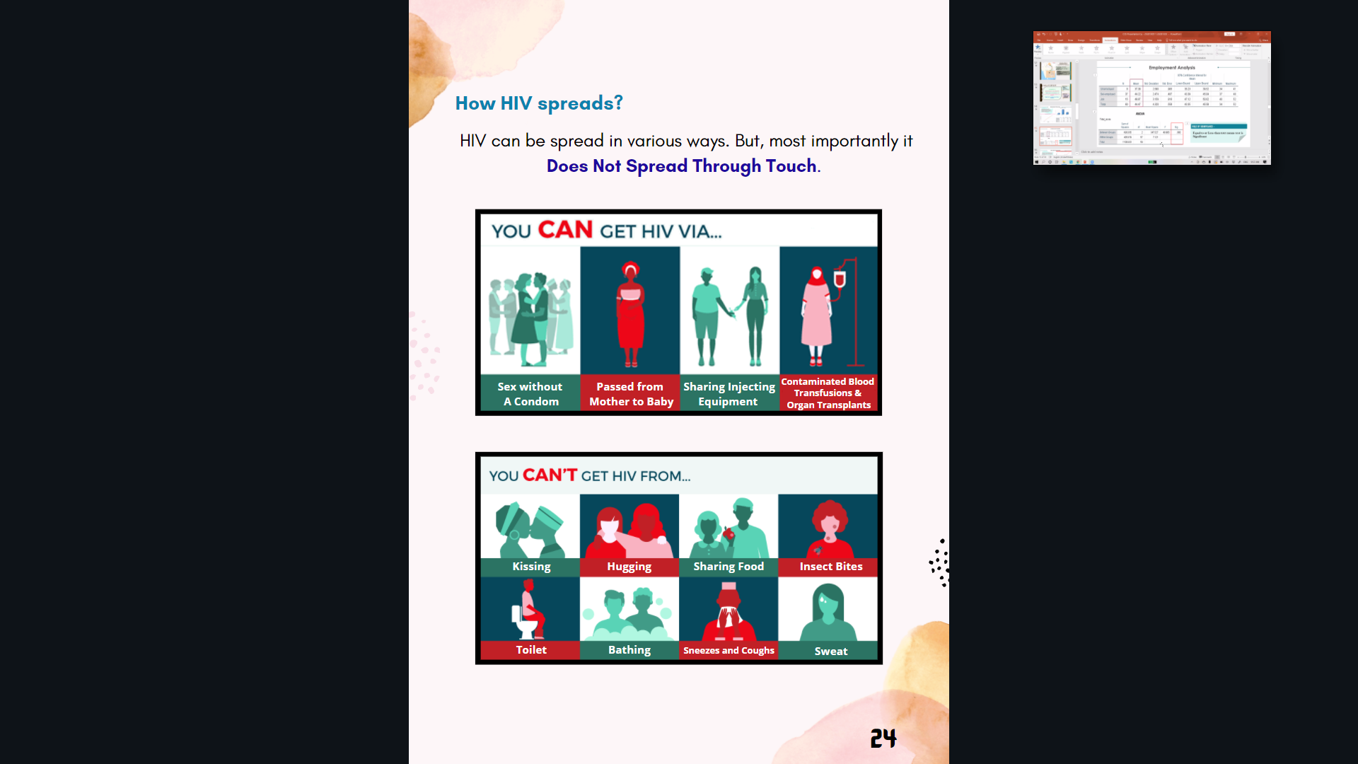
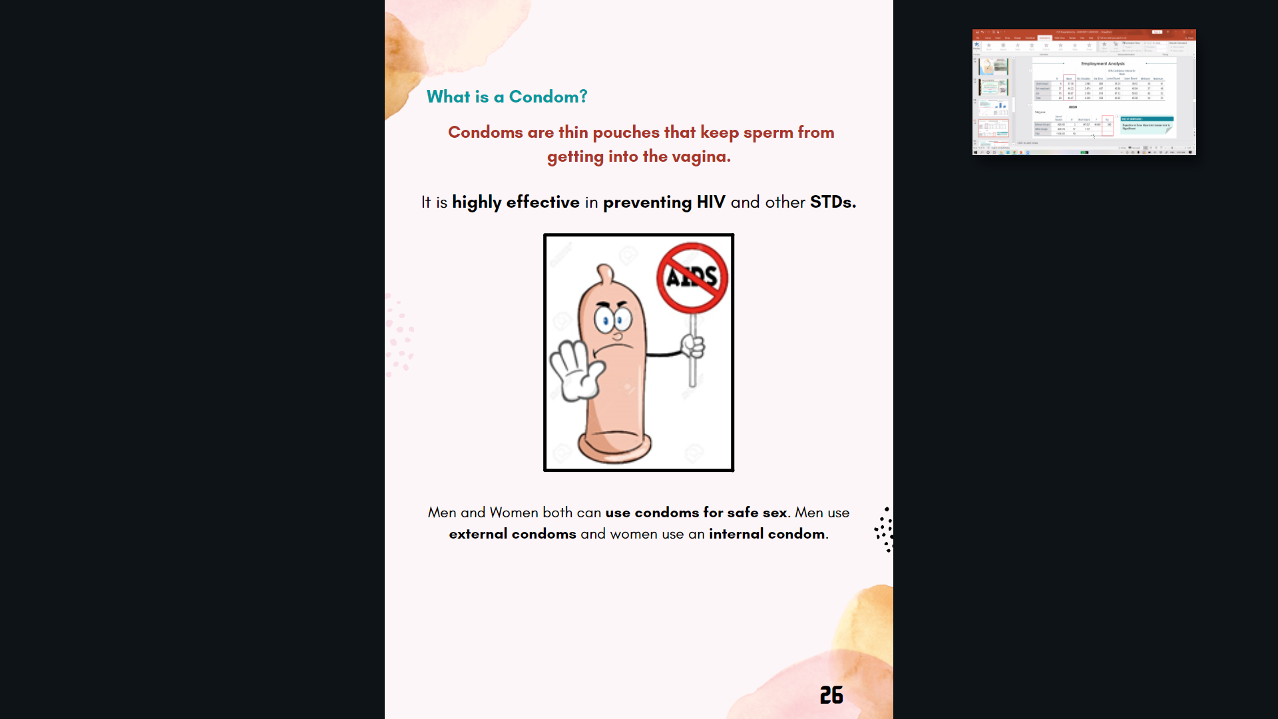
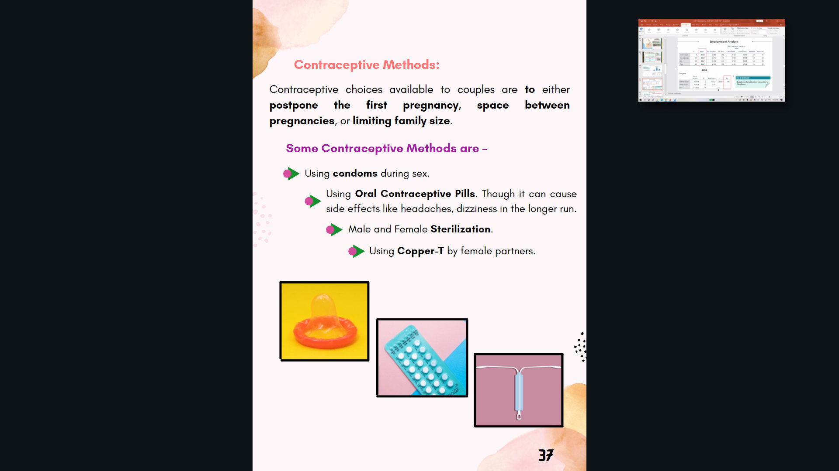
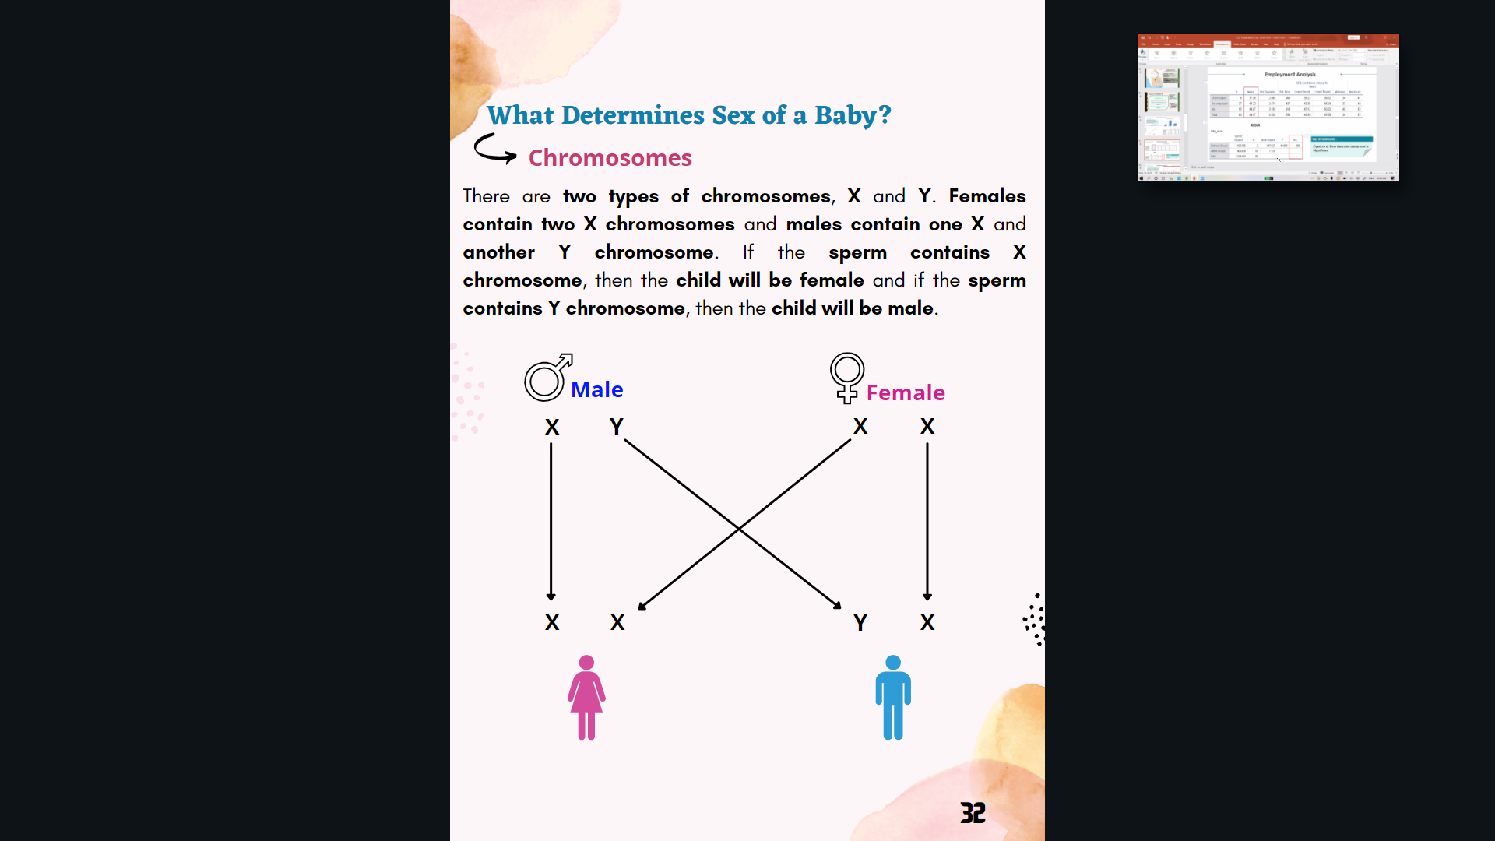
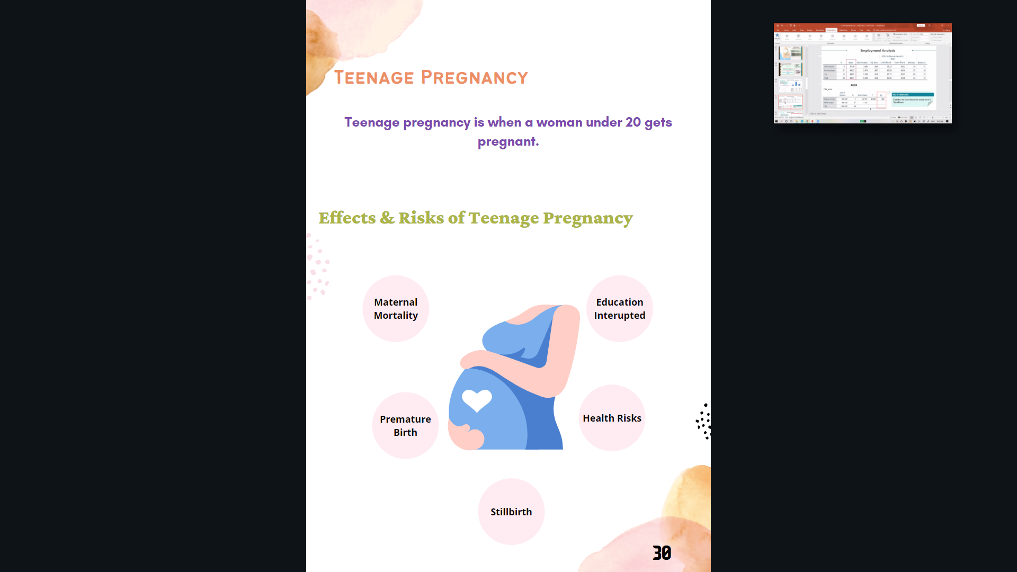
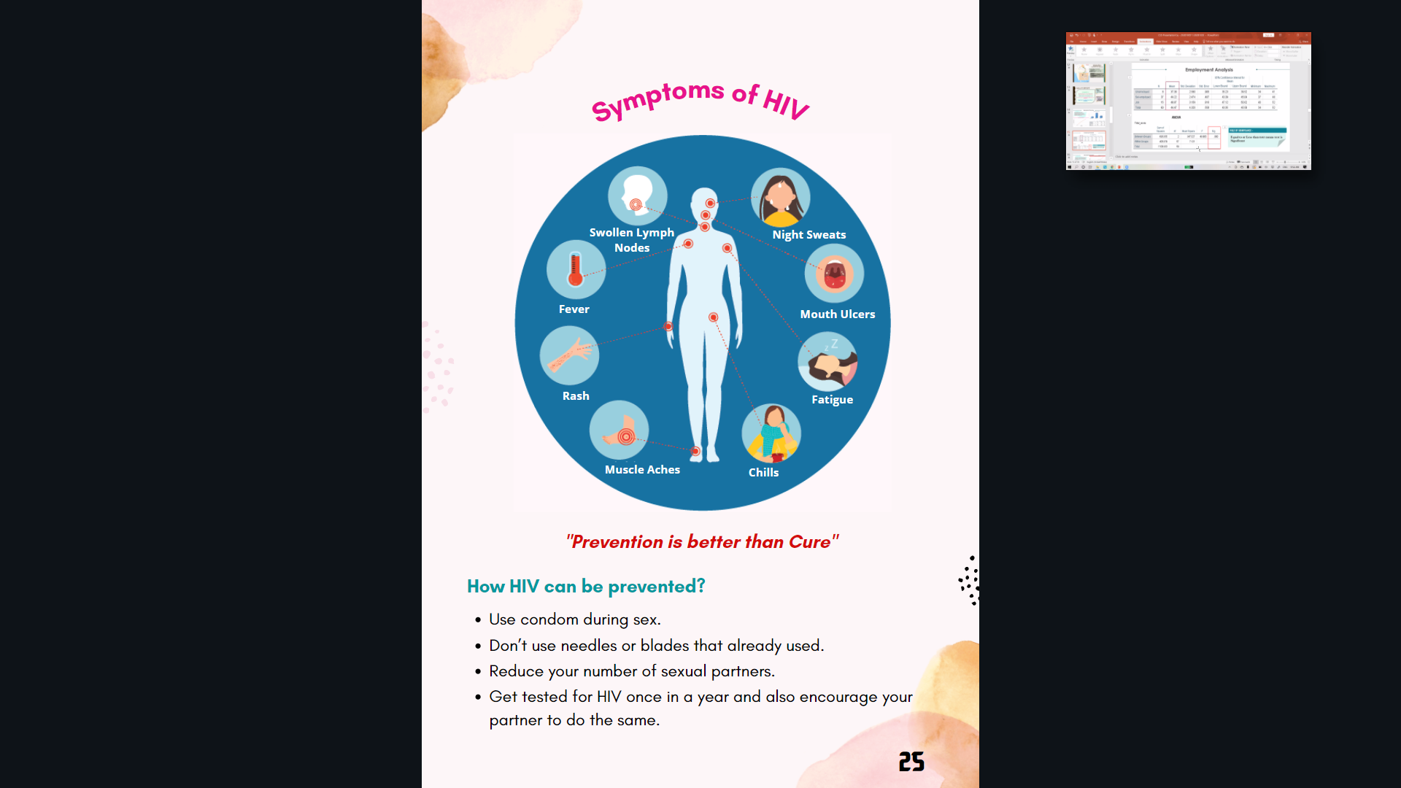
M o d u l e

Slide 20
r e f e r e n c e s
WBBSE & WBCHSE Biology Books
NCERT Books ( X, XI, XII)
https://www.aboutkidshealth.ca/Article?contentid=716&language=English
http://recapp.etr.org/recapp/index.cfm?fuseaction=pages.learningactivitieshome
https://iyfglobal.org/sites/default/files/library/P4L_Lessons_St_Lucia.pdf
https://byjus.com/biology/reproductive-health/
https://www.advocatesforyouth.org/wp-content/uploads/storage/advfy/lesson-plans/lesson-plan-anatomy-and-physiology-part-i-and-ii.pdf
https://www.vedantu.com/biology/reproductive-health
https://www.commonsense.org/education/lesson-plans/female-reproductive-system
https://www.khanacademy.org/science/high-school-biology/hs-human-body-systems/hs-the-reproductive-system/v/welcome-to-the-reproductive-system

Slide 21
T H A N K
Y O U

